Slide 1


FLUTTER DONE RIGHT ?
by Luis Pulido.

Slide 2
Who is this guy?
Bachelor in Computer Science with a Master in Computer Graphics and a big love for OpenGL.
I wanted to make video games with Unity3D!
Toronto is not easy for game dev (too much competition, low salaries)
Xamarin Certified Mobile Developer.
I’m a Flutter Enthusiast that wants to learn more while sharing what I know.
I work at T4G.

Slide 3
What’s for today?
Design Patterns.
Use what’s there.
Nomenclature, Code Formatting and Style Guide.
Folder Structure.
Inversion of Control.
Test Driven Development.
Testing Flutter Apps.
Tools for Continuous Integration.
Tools for Continuous Delivery.

Slide 4


Design Patterns and Software Architecture
MVVM
MVC
package:mvc
MVP
Scoped Model
package:scoped_model
Redux
package:redux
Bloc

Slide 5

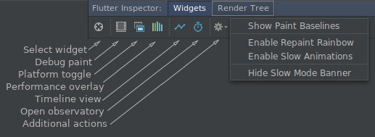

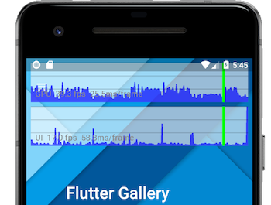
Use what’s there!
Hot Reload
Hot Restart
UI Inspector
Performance Profiler
flutter run –profile

Slide 6
Nomenclature, Code Formatting and Style Guide
Code Style guide
(https://github.com/flutter/flutter/wiki/Style-guide-for-Flutter-repo)
Automatic Formatting: SHORTCUT! (Alt + Shift + L, Ctrl + K + Ctrl + F)
flutter format command
Extensions
Trailing commas, (yes, do, not, forget, them,),
_privateProperty or _privateMethod()
CamelCase abstract class, CamelCaseImpl for implementations and CamelCaseMock for Mocked classes.
lowerCamelCase constants (don’t do CONSTANT but you might do kConstant)
Avoid var (figure out your type!) same as your method’s return type.
Order your class members in a way they make sense
Close your Streams!
Do not initialize properties unless they’re final!

Slide 7
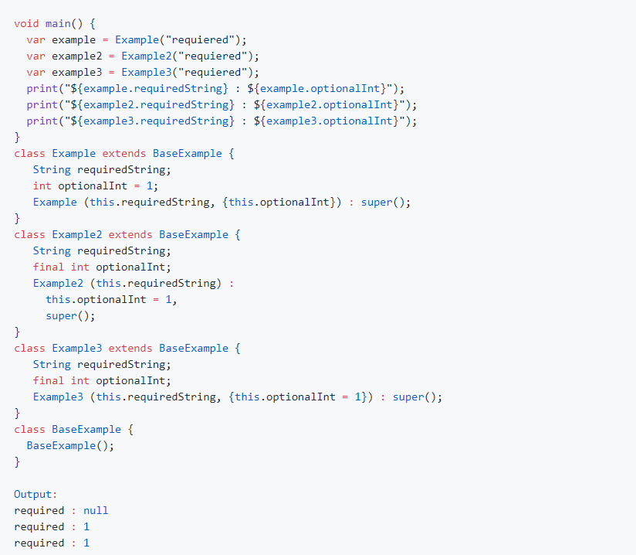

Slide 8
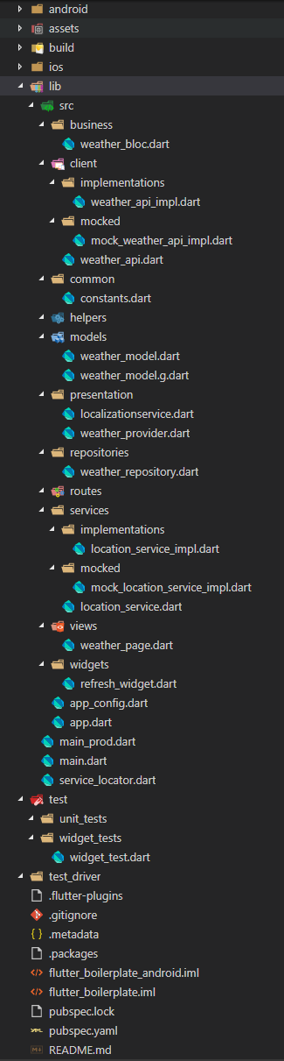
Folder Structure
But there’s no silver bullet!

Slide 9

Inversion of Control (IoC)
Service Locator
package:get_it
Dependency Injection
package:inject
THIS IS VERY IMPORTANT! (yes, take notes)

Slide 10
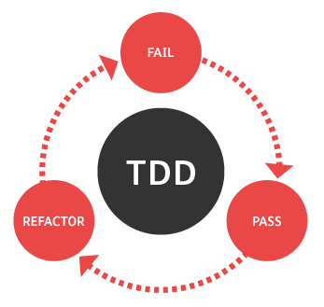
Test Driven Development
Your task is not done until the Test is done (and passes!)
Use Mocked services and/or data so your tests are always predictable
Include “bad case scenario” in your tests
Cover as much as you can!

Slide 11

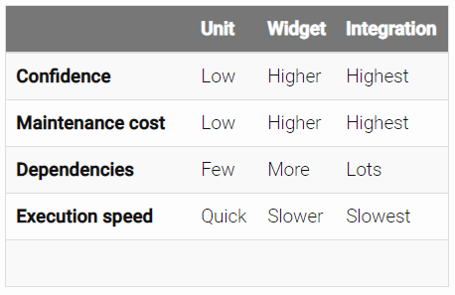
Testing Flutter Apps

Slide 12






Tools for Continuous Integration
Travis
CircleCI
Cirrus
Pipelines
VSTS

Slide 13


Tools for Continuous Delivery
FastLane
Pipelines (Bitbucket Bamboo)
AppCenter

Slide 14

Flutter Done Right?
IN.
Any Questions?

Slide 15

GRACIAS!
Luis.Pulido@t4g.com
@nosmirck

